Slide 1

Student Score Prediction
Presented by [Rana Awad Abdel Aziz Saad]

Slide 2



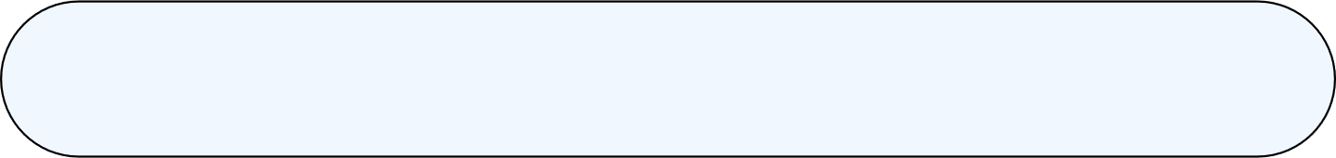

1
Project Overview
Agenda
2
Dataset Overview
3
Data Processing
4
Model Training
5
ScoreData Visualization
6
Model Evaluation
7
Prediction
8
Challenges
9
Conclusion

Slide 3
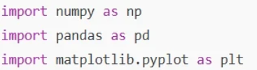

Project Overview
Goal: Predict student scores based on study hours.
Tools Used: Python, Pandas, NumPy, Matplotlib, Scikit-learn
Algorithm: Linear Regression

Slide 4
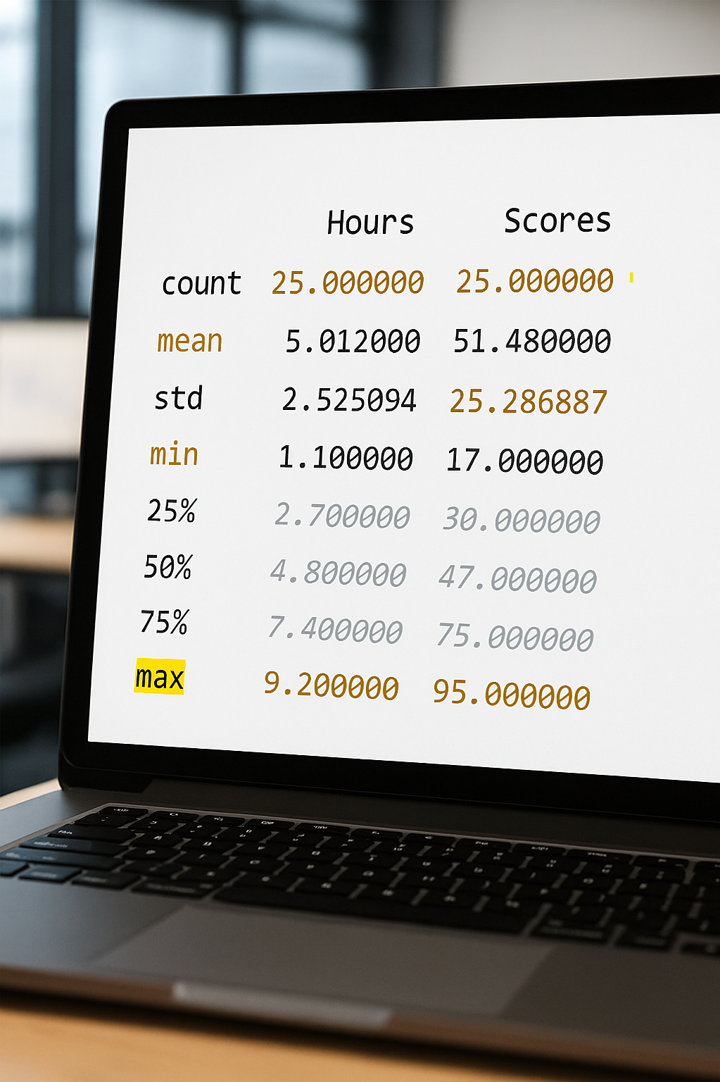
Overview of the dataset used
The dataset for the Student Score Prediction Project consists of 25 records detailing the relationship between study hours and exam scores. Each record contains two columns: one representing study hours and the other representing exam scores. Importantly, the dataset has no missing values, ensuring a complete analysis.
The mean study hours recorded is approximately 5 hours, while the mean exam score is around 51 points. This average indicates a moderate level of study time correlated with exam performance. The dataset provides a solid foundation for applying linear regression techniques, allowing us to explore how variations in study hours can predict student performance on exams. The next step involves preprocessing this data to visualize its characteristics effectively.

Slide 5

Data Processing
  We checked for missing values — none were found
  we split the data into:
  Training Set (80%) to train the model
  Testing Set (20%) to evaluate its accuracy

Slide 6



Model Training
We used the Linear Regression model which
  learns the relationship between hours (input) and scores (output).
  finds a straight line (y = a*x + b) that best fits the data.
Here,
x = Hours
y^​ = predicted score
a = slope (coef)
b = intercept

Slide 7
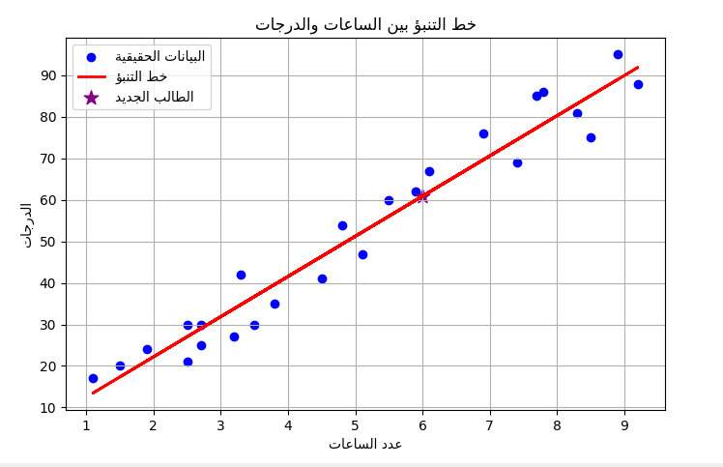
Data Visualization of Scores
Hours vs. Scores Scatter Plot
This plot shows a strong positive correlation.
Blue = Real data
Red = Prediction line
Purple = New student entered manually

Slide 8

Model Evaluation
  We used two metrics:
  MSE (Mean Squared Error) = 18.94 →
  R² (R-squared) = 0.967 → means the model explains 96.7% of the relationship between hours and scores.
18.94
0.96
Mean Squared Error (MSE) measures average prediction error lower is the better
R-squared Value
the model explains 96.7% of the relationship between hours and scores. Closer than 1 is the better

Slide 9

Prediction
  Input = 6 study hours “manually “
  Predicted score = 9.78×6 + 2.48 ≈ 60.92

Slide 10
Challenges
  Small dataset (only 25 records).
  Simple model (only one feature).
  Real-life data may include other factors like attendance, sleep, or stress.

Slide 11


Conclusion
This project demonstrates the power of Machine Learning in education
It provides valuable insights into how study time affects student performance.
More study hours → Higher score

Slide 12
Thank You for Your Attention
Email
Github
ranaawad20199@gmail.com
https://github.com/ranaawad2011/Python-script

